Slide 1
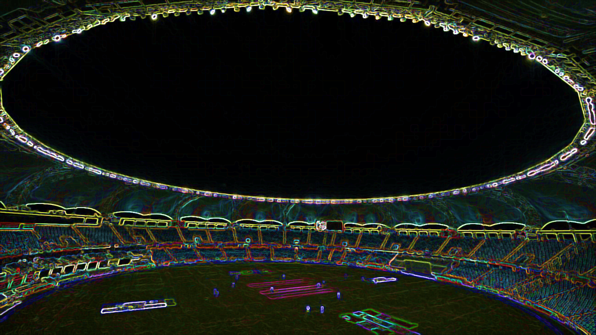









CASE STUDY ON IPL ANALYSIS

Slide 2
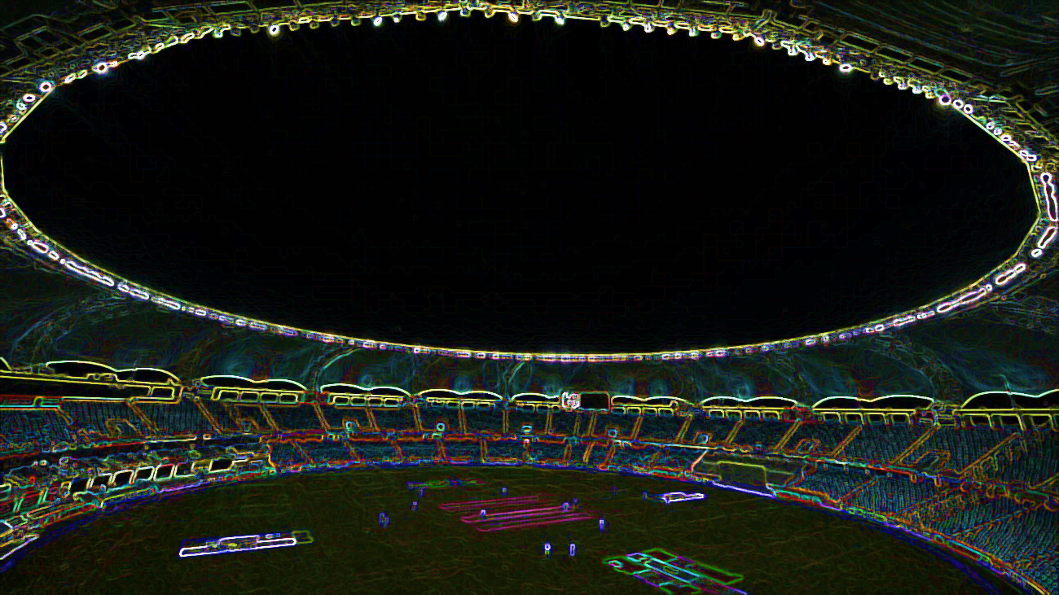
Team details
TEAM MEMBER | ROLES
SONALI VERMA | TEAM LEAD
SIDDHARTHA GUPTA | TEAM LEAD
JITENDRA KUMAR GUPTA | DATASTAGE
KESHAV RANA | DATASTAGE
MANISH VISHWAKARMA | DATASTAGE
SHIKHA AGGARWAL | QLIK
JOYDEEP MAITY | QLIK
ARASHPREET SINGH | QLIK

Slide 3
PROBLEM STATEMENT
DEVELOPMENT OF IPL SEASONWISE PERFOMANCE ANALYSIS TO ANALYZE FOLLOWING SCENARIOS:
Which team won the highest number of matches season-wise?
Percentage of winning matches after winning tosses?
Top 3 stadium to host maximum number of matches in all seasons.

Slide 4
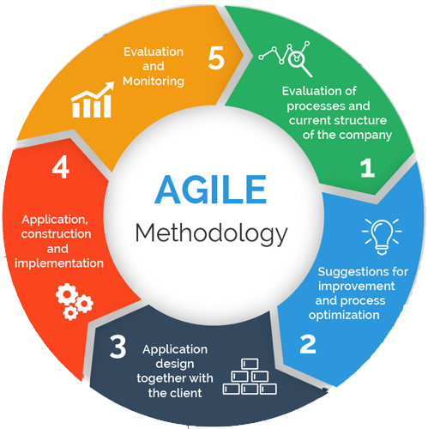
PROJECT METHODOLOGY:
Agile is a process by which a team can manage a project by breaking it up into several stages and involving constant collaboration with stakeholders and continuous improvement and iteration at every stage.

Slide 5
STAGES
DESIGN &
ANALYSIS
PLANNING
TESTING
IMPLEMENTATION

Slide 6

STAGE 1: PLANNING
In this stage we plan our project and answer many questions related to our project. Such as:
Requirement of the customer.
Deadline of the project.
Day by Day/Week by Week target of project.
Role of different team members.

Slide 7
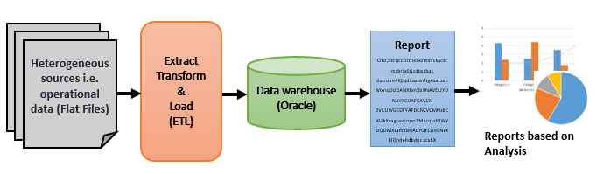
STAGE 2: DESIGN & ANALYSIS
In the design & analysis phase we basically design the flow of project and a brief analysis of our implementation phase.
Three primary activities of this stage are:
Gathering business requirements.
Creating process diagram.
Performing a detailed analysis.

Slide 8


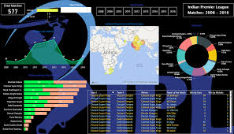
STAGE 3: IMPLEMENTATION
In the implementation phase, all the documents from the previous phase are transformed into the actual system
REPORT
ETL
DASHBOARD

Slide 9
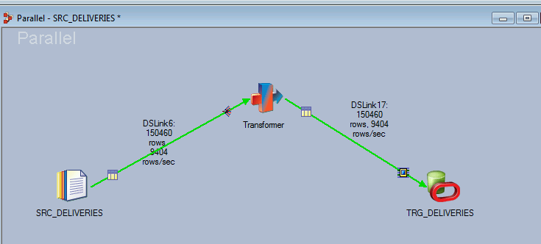
STAGE 3.1: etl
Fig 3.1.1 EXTRACTING SOURCE FILE TO TARGET TABLE

Slide 10
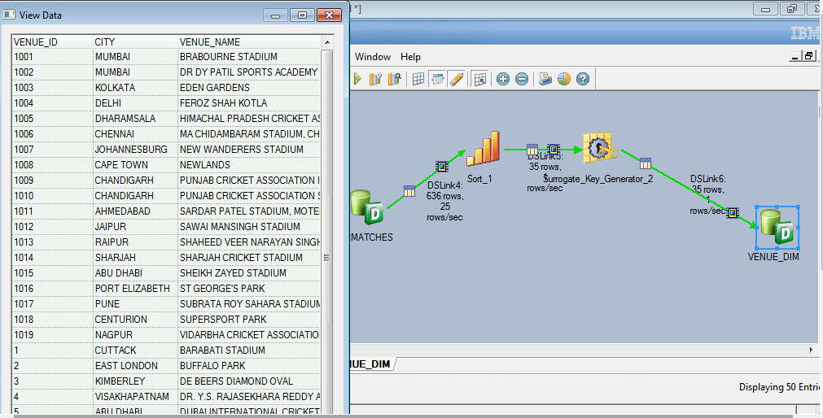
STAGE 3.1: etl
Fig 3.1.2 VENUE DIMENSION TABLE

Slide 11
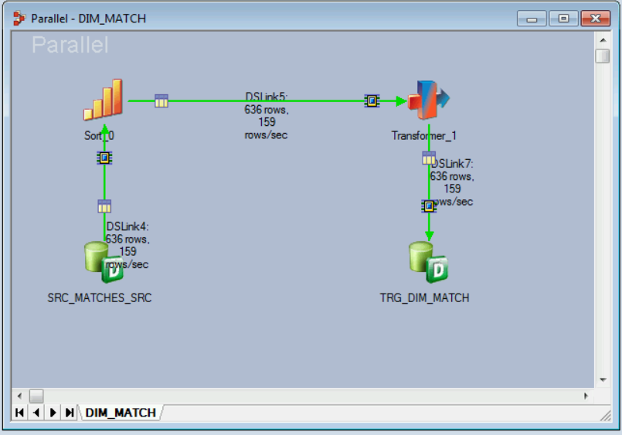
STAGE 3.1: etl
Fig 3.1.3 MATCH DIMENSION TABLE

Slide 12
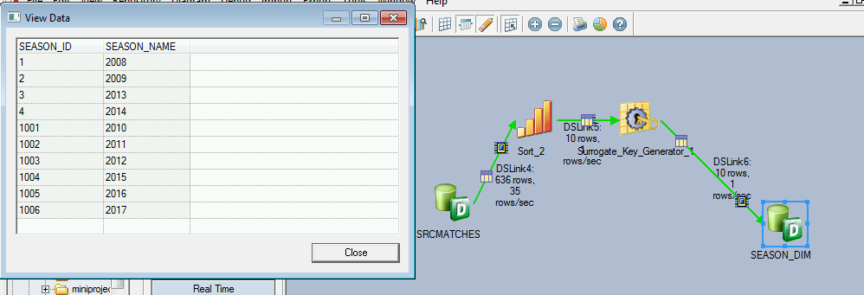
STAGE 3.1: etl
Fig 3.1.4 SEASON DIMENSION TABLE

Slide 13
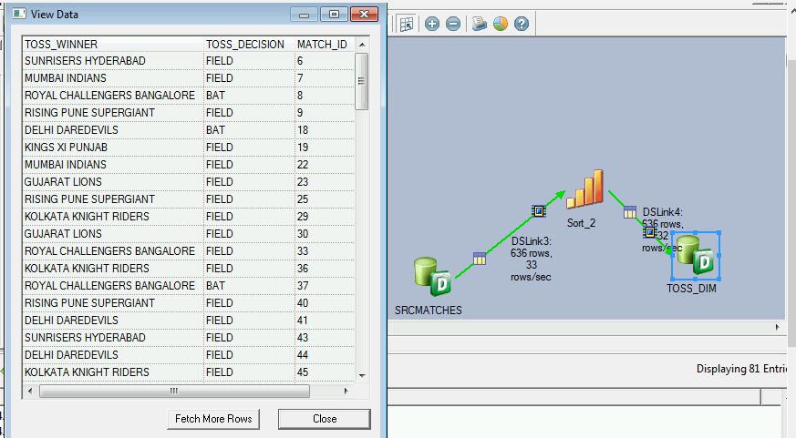
STAGE 3.1: etl
Fig 3.1.5 TOSS DIMENSION TABLE

Slide 14
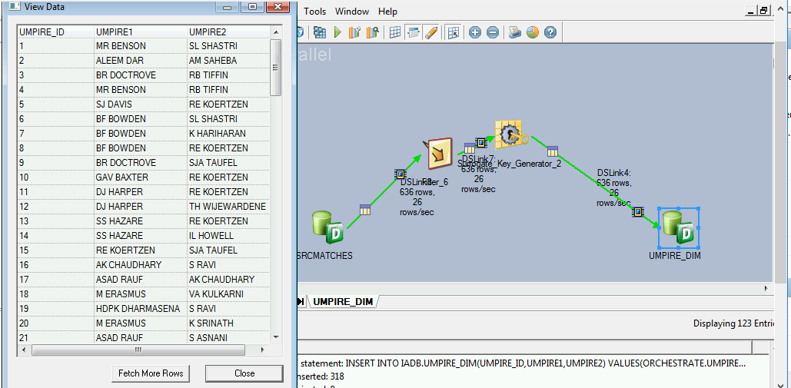
STAGE 3.1: etl
Fig 3.1.6 UMPIRE DIMENSION TABLE

Slide 15
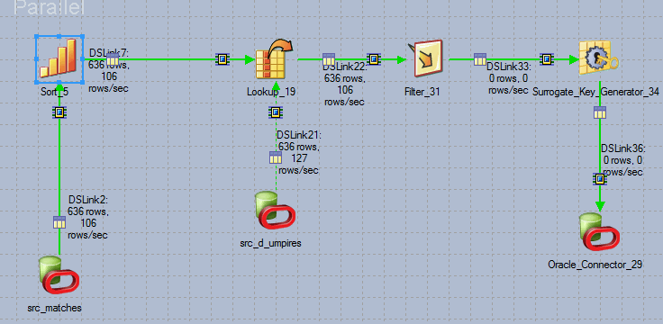
STAGE 3.1: etl
Fig 3.1.7 INCREMENTAL LOAD

Slide 16
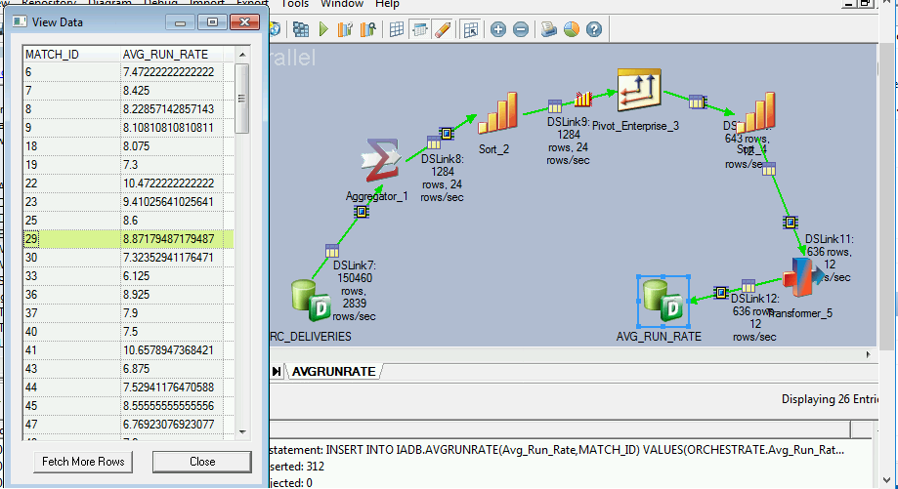
STAGE 3.1: etl
Fig 3.1.8 AVERAGE RUN RATE

Slide 17
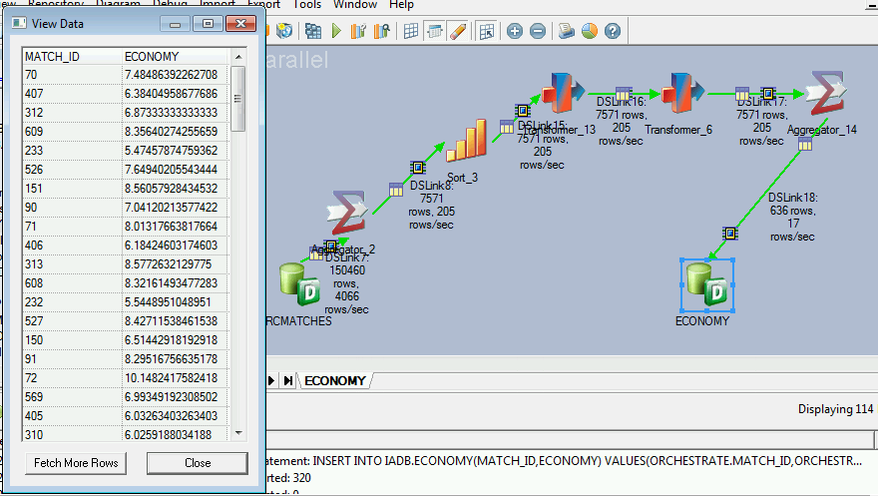
STAGE 3.1: etl
Fig 3.1.9 ECONOMY

Slide 18
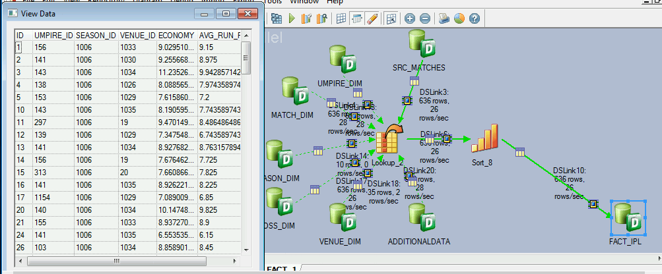
STAGE 3.1: etl
Fig 3.1.10 FACT TABLE

Slide 19
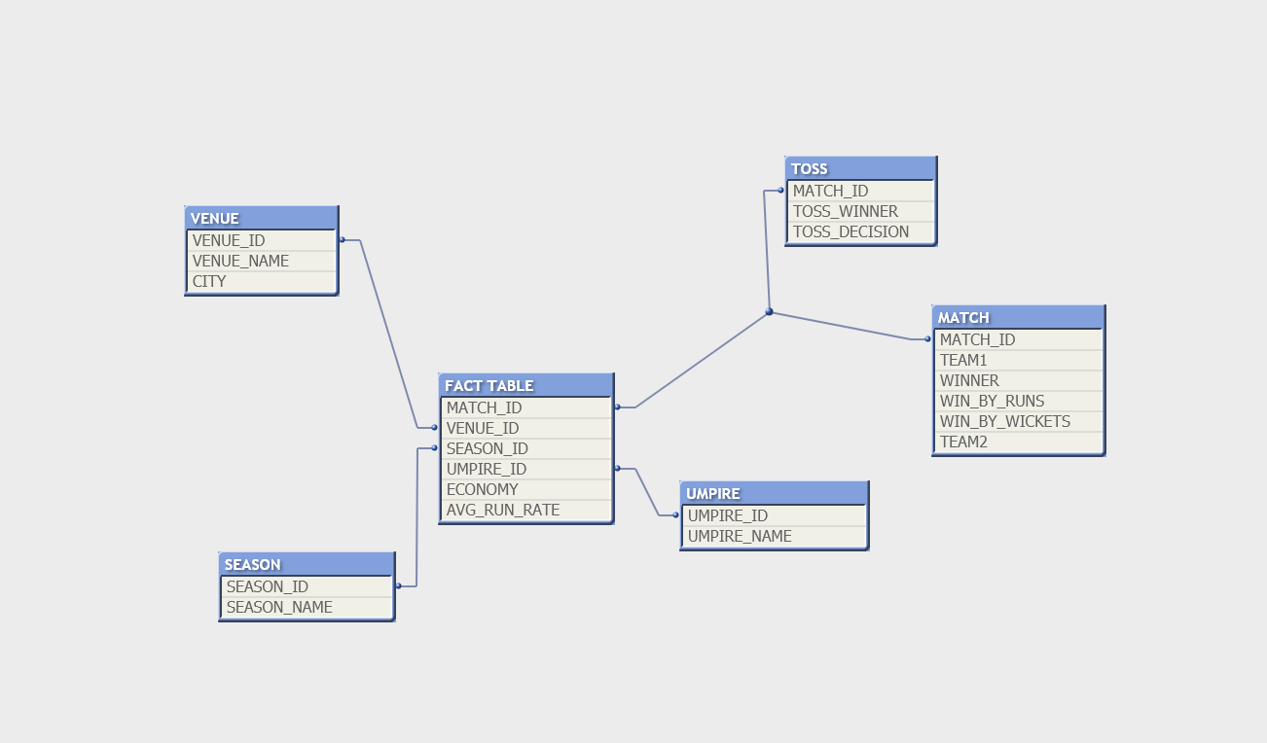
STAGE 3.1: etl
Fig 3.1.11 SCHEMA DESIGN

Slide 20
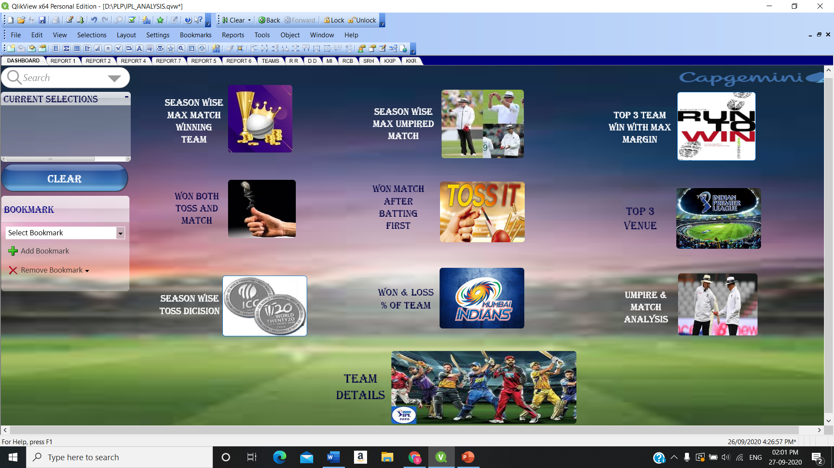
STAGE 3.2 : dashboard
Fig 3.2.1 MAIN DASHBOARD

Slide 21
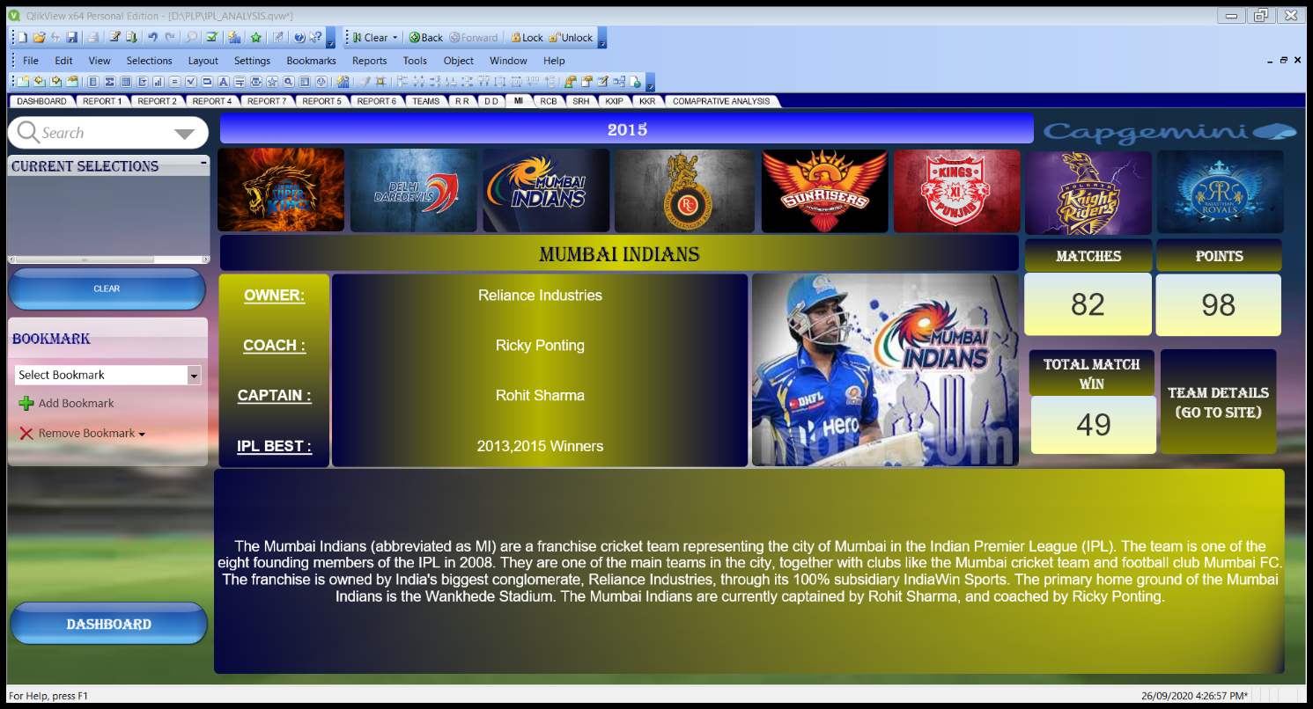
STAGE 3.2 : dashboard
Fig 3.2.2 MI TEAM DASHBOARD

Slide 22
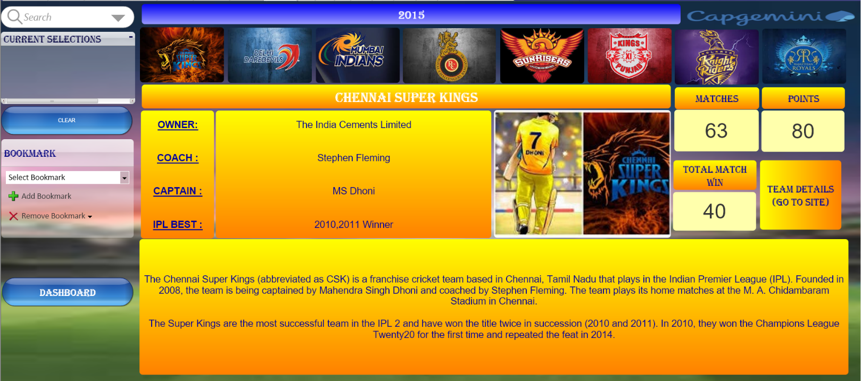
STAGE 3.2 : dashboard
Fig 3.2.3 CSK TEAM DASHBOARD

Slide 23
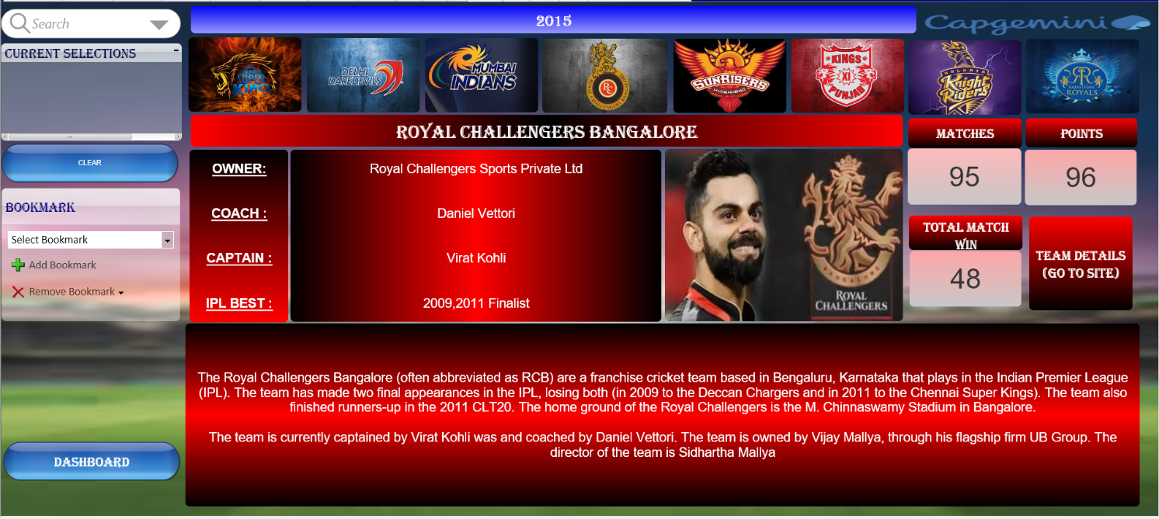
STAGE 3.2 : dashboard
Fig 3.2.4 RCB TEAM DASHBOARD

Slide 24
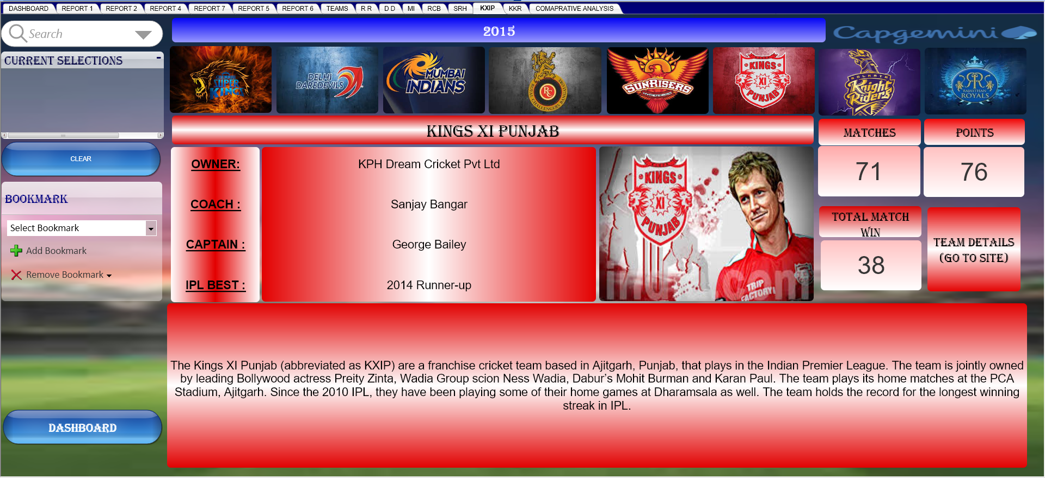
STAGE 3.2 : dashboard
Fig 3.2.5 KXIP TEAM DASHBOARD

Slide 25
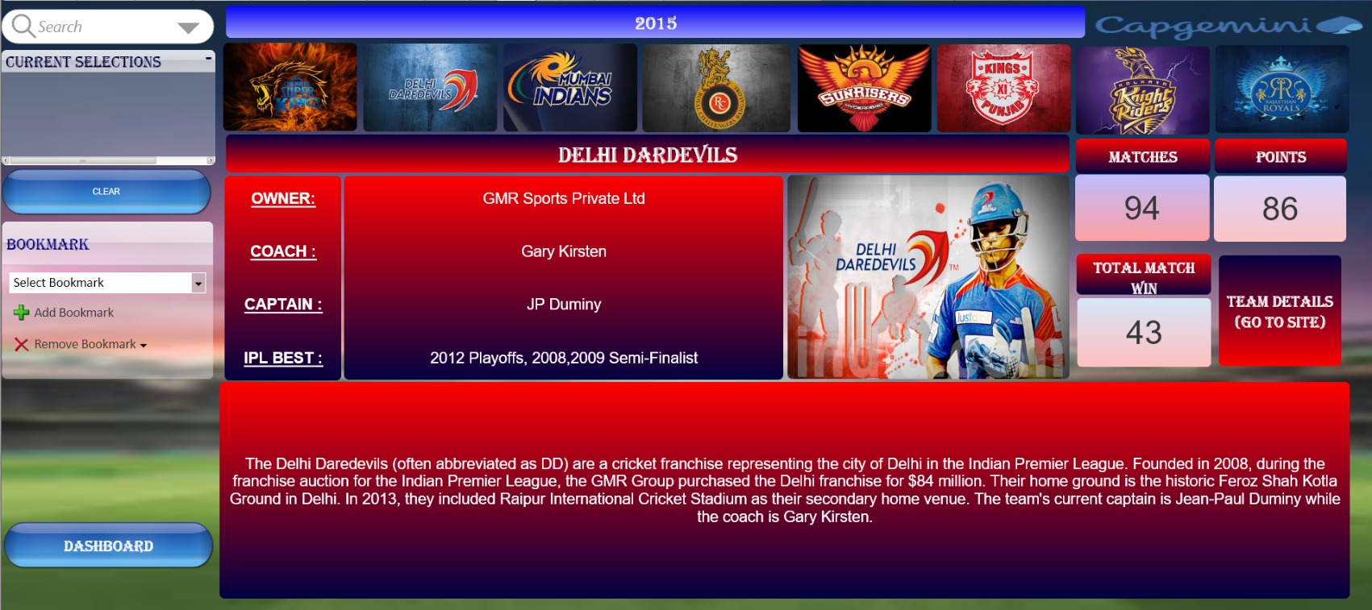
STAGE 3.2 : dashboard
Fig 3.2.6 DD TEAM DASHBOARD

Slide 26
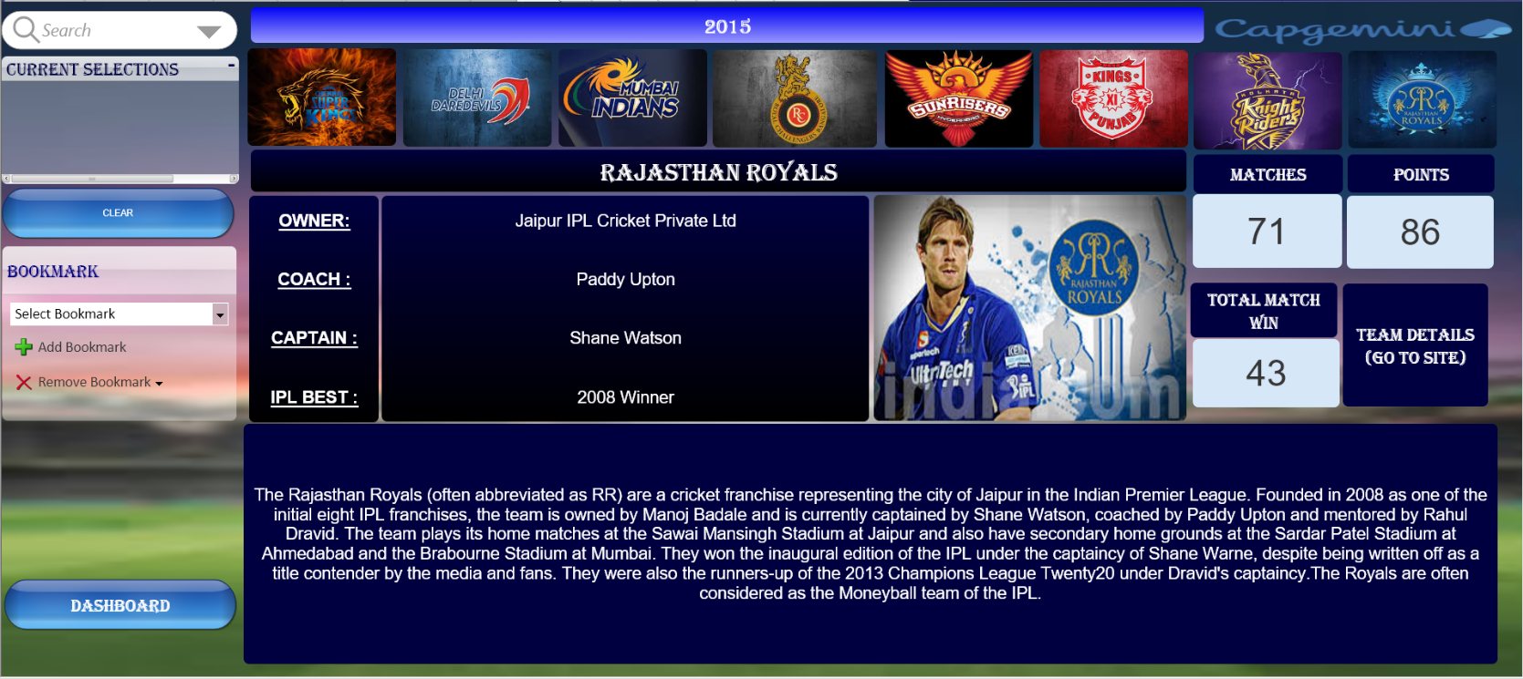
STAGE 3.2 : dashboard
Fig 3.2.7 RR TEAM DASHBOARD

Slide 27
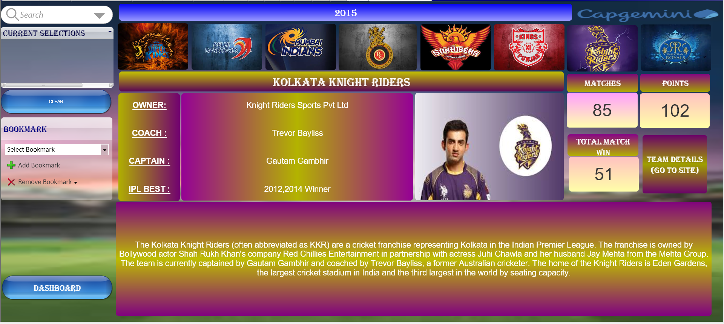
STAGE 3.2 : dashboard
Fig 3.2.8 KKR TEAM DASHBOARD

Slide 28
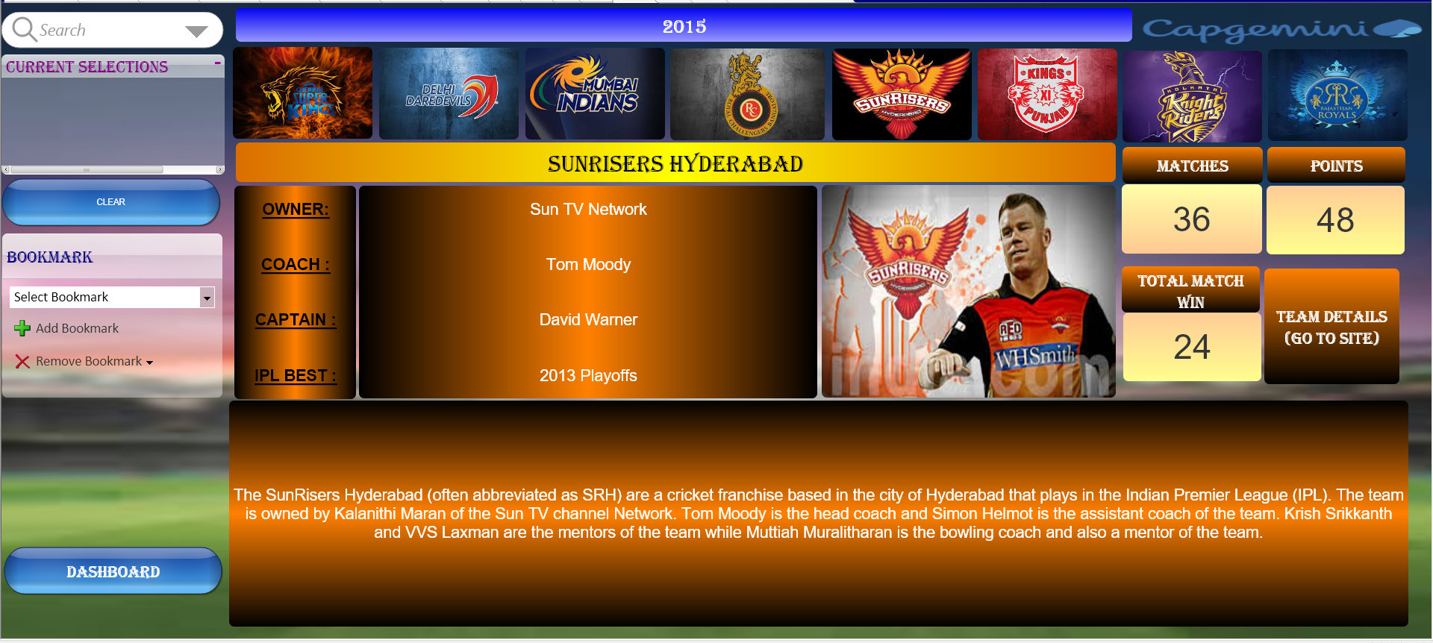
STAGE 3.2 : dashboard
Fig 3.2.9 SRH TEAM DASHBOARD

Slide 29
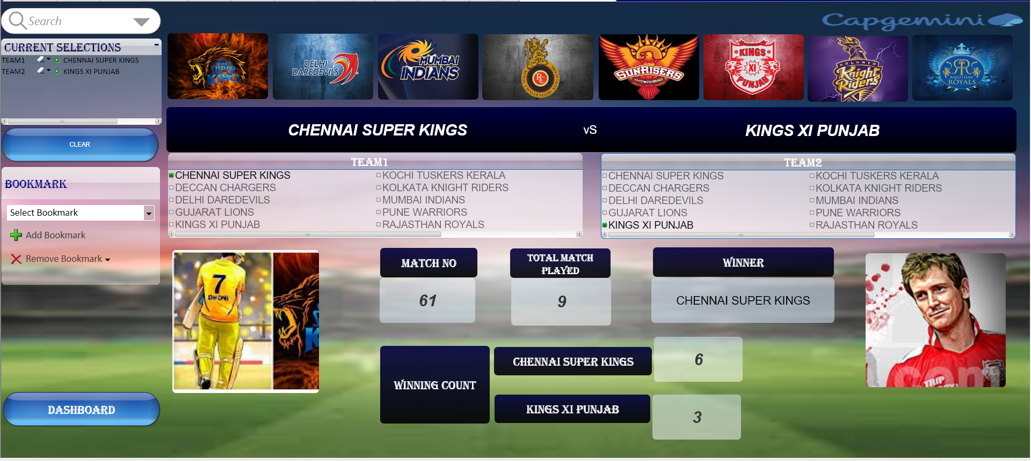
STAGE 3.2 : dashboard
Fig 3.2.10 COMPARITIVE ANALYSIS

Slide 30
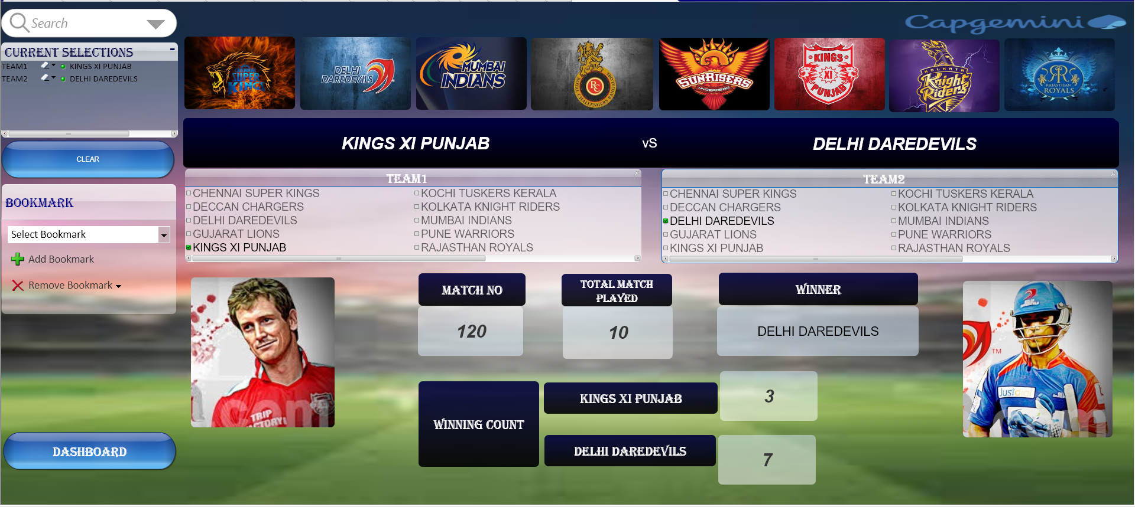
STAGE 3.2 : dashboard
Fig 3.2.11 COMPARITIVE ANALYSIS

Slide 31
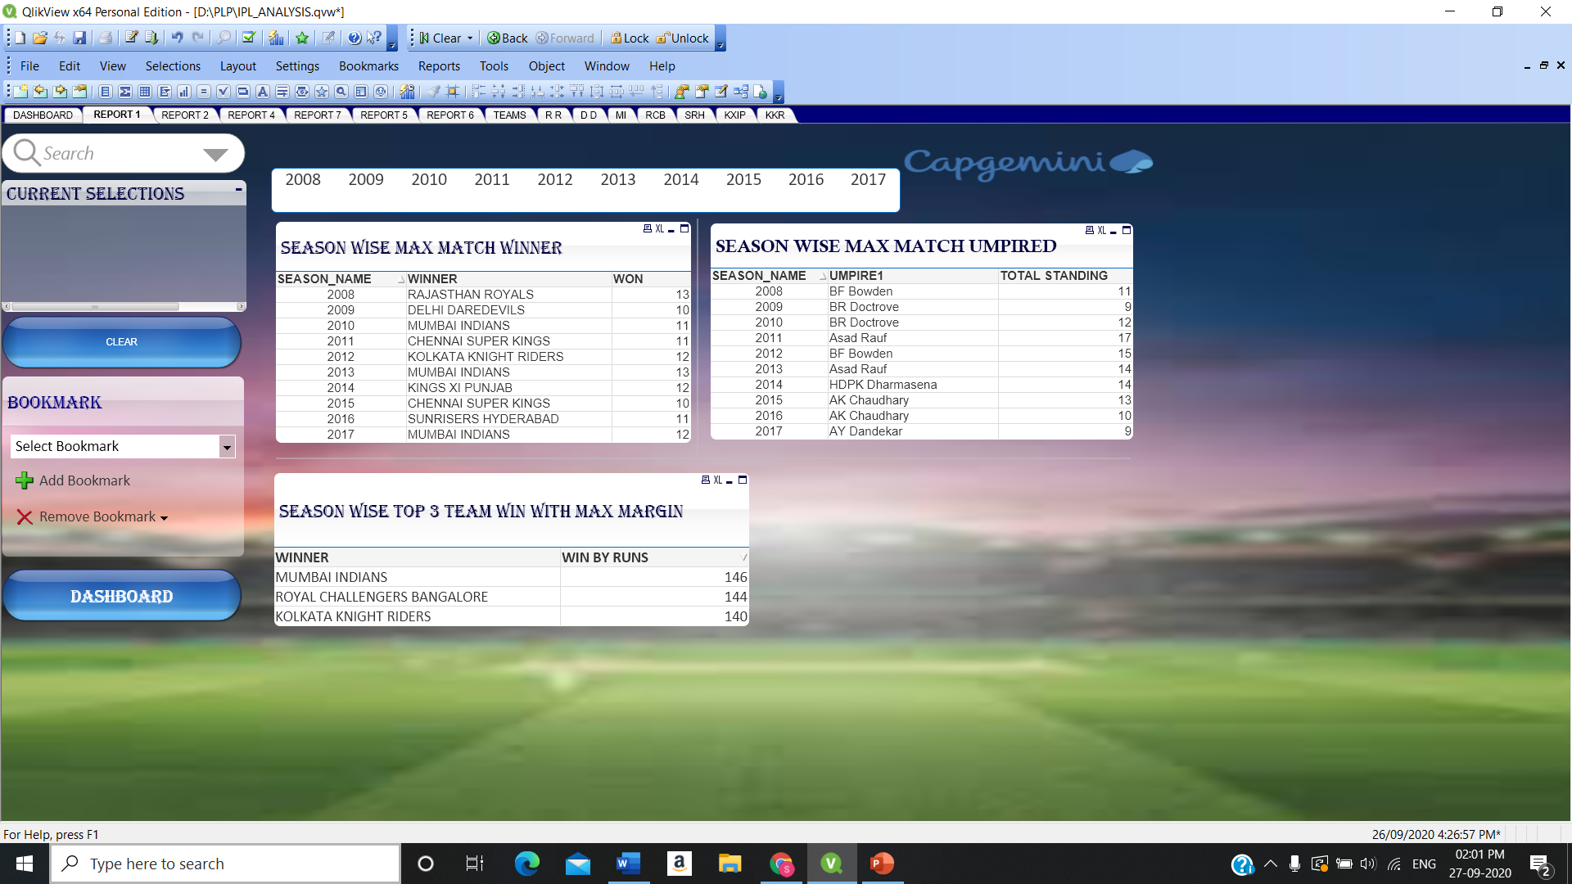
STAGE 3.3 : REPORTS
Fig 3.3.1 ANALYSIS I

Slide 32
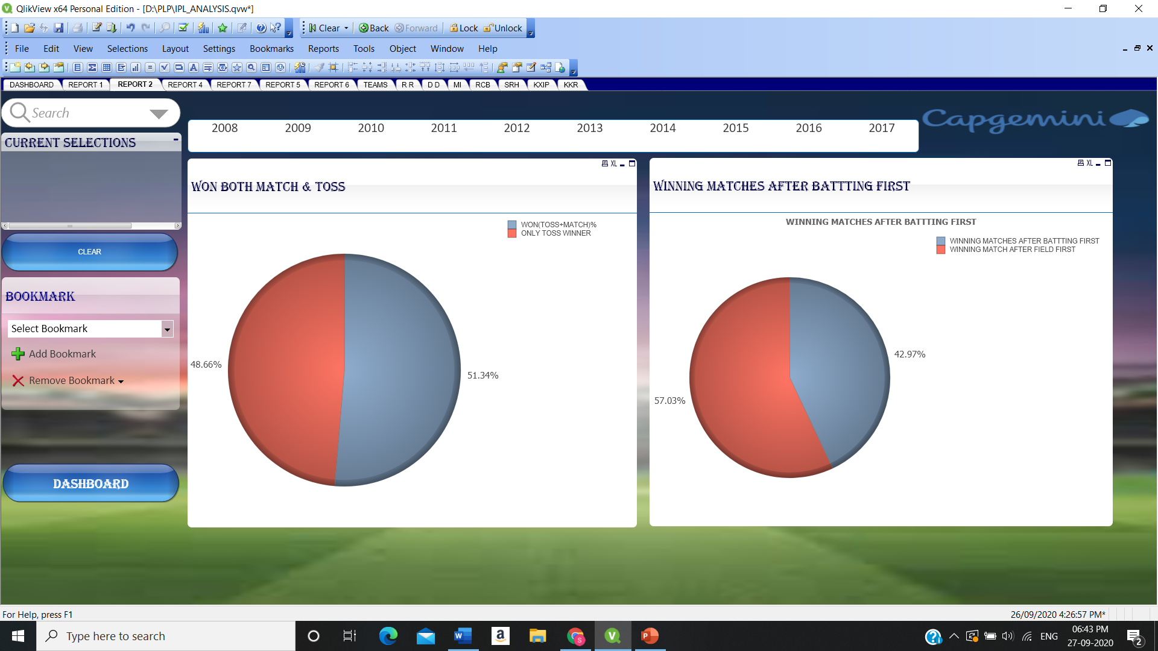
STAGE 3.3 : REPORTS
Fig 3.3.2 ANALYSIS II

Slide 33
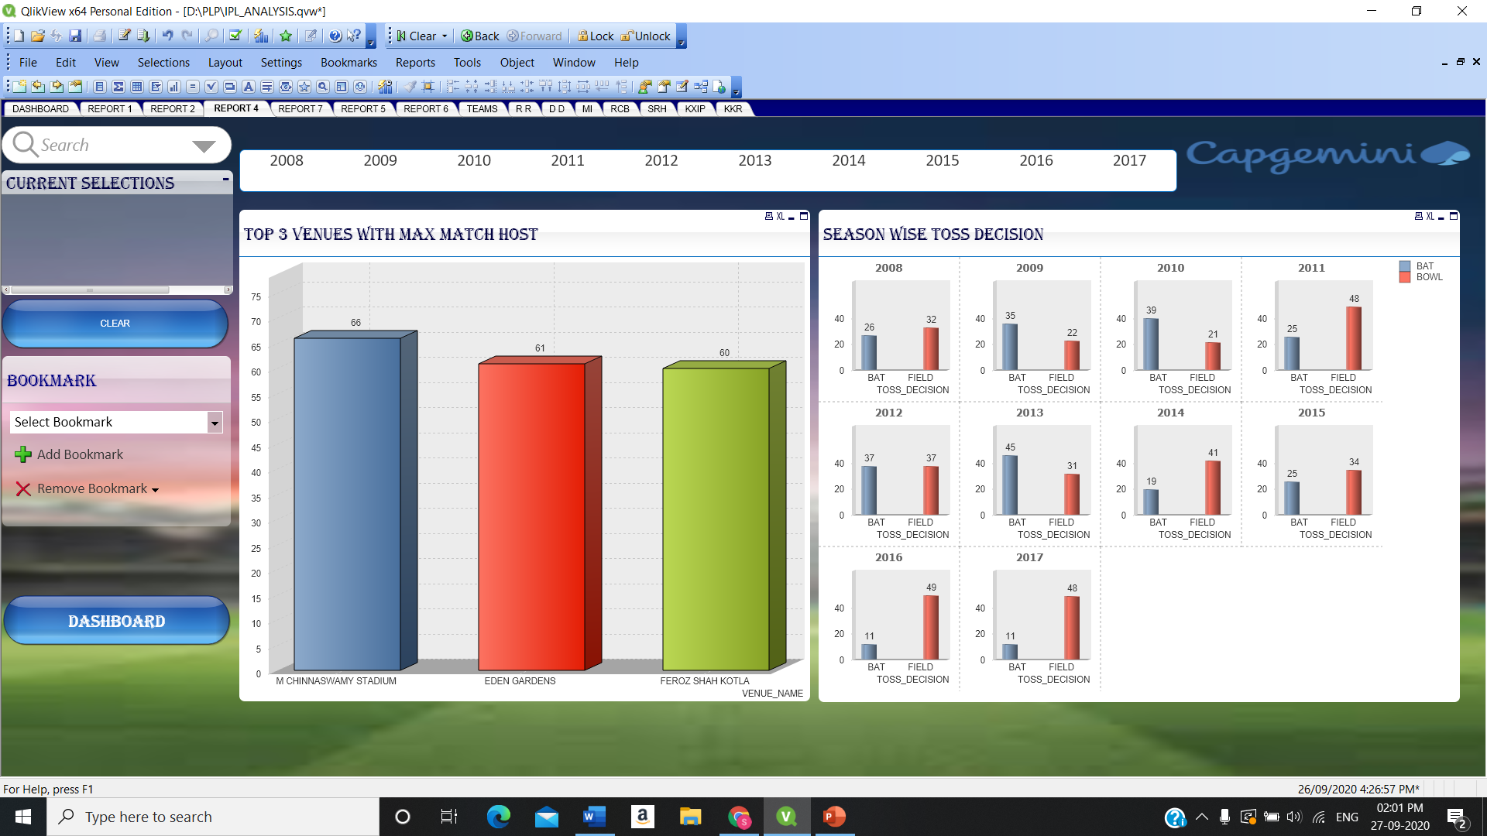
STAGE 3.3 : REPORTS
Fig 3.3.3 ANALYSIS III

Slide 34
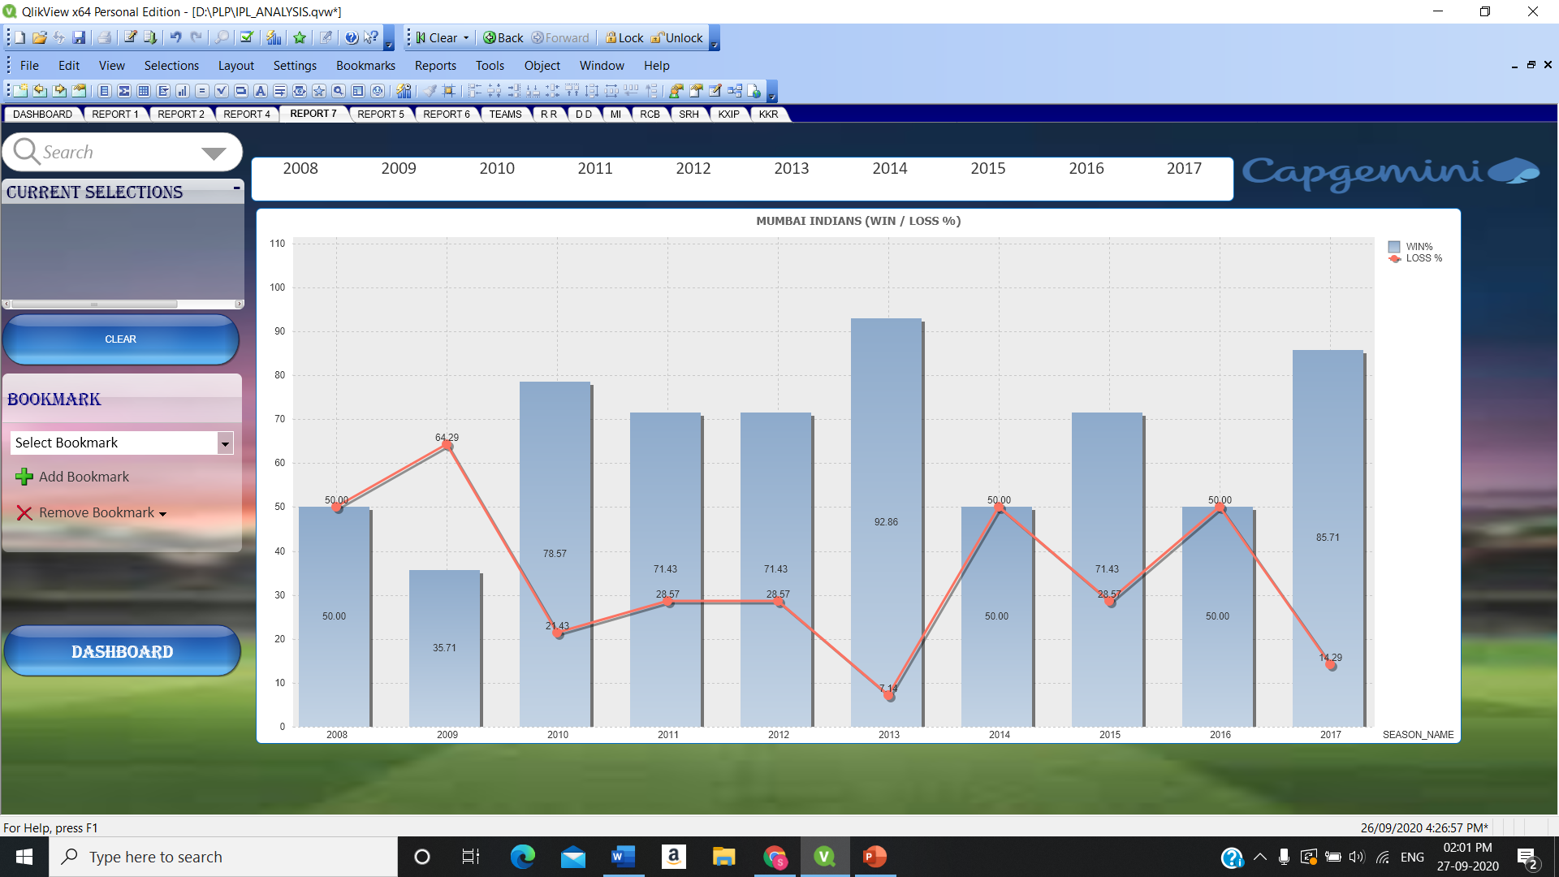
STAGE 3.3 : REPORTS
Fig 3.3.4 ANALYSIS IV

Slide 35
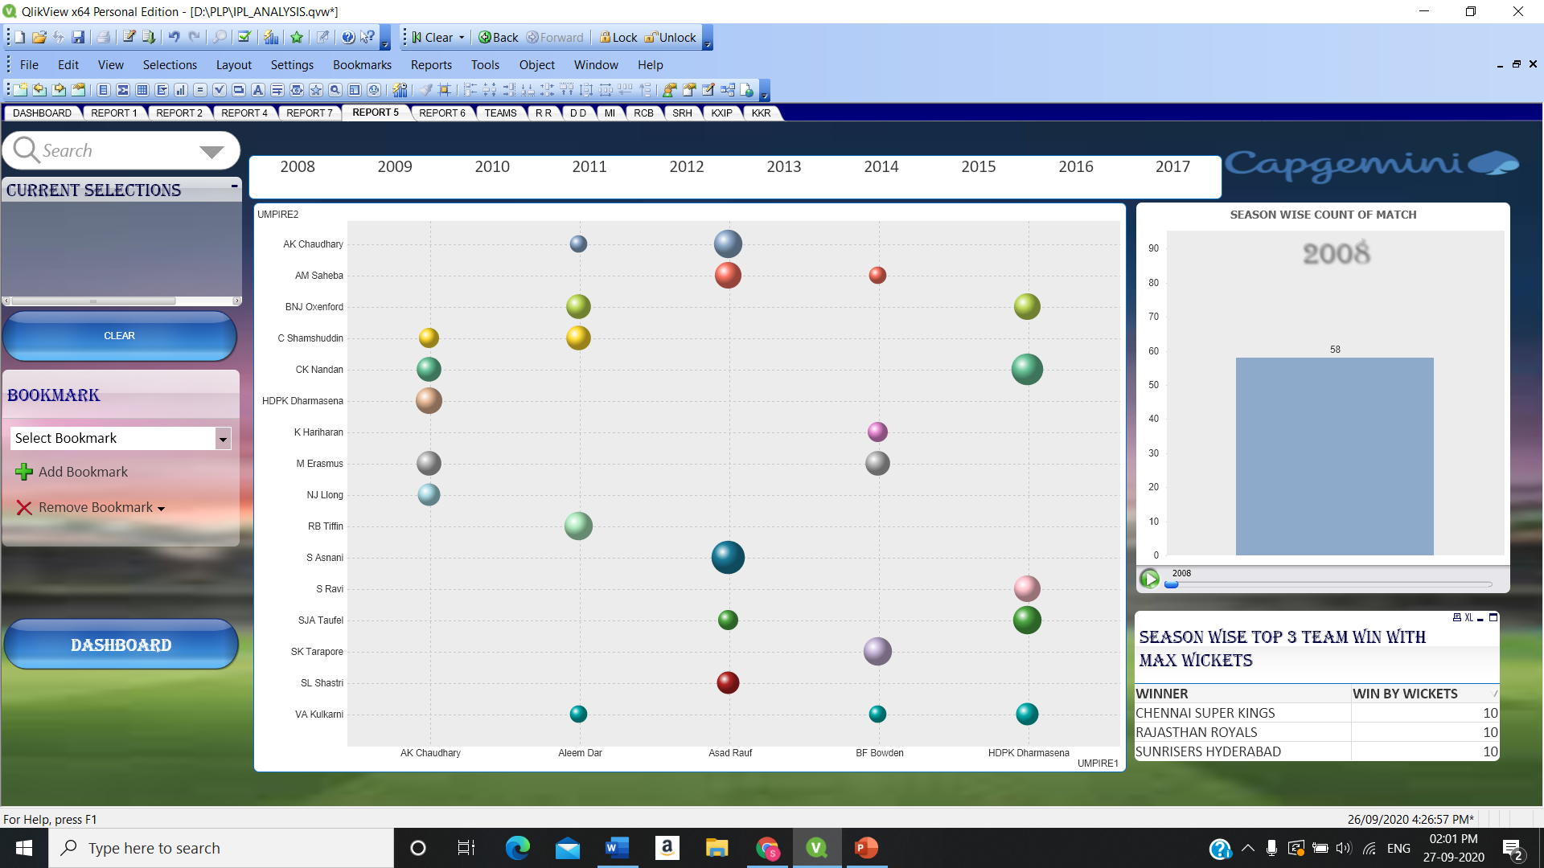
STAGE 3.3 : REPORTS
Fig 3.3.5 ANALYSIS V

Slide 36
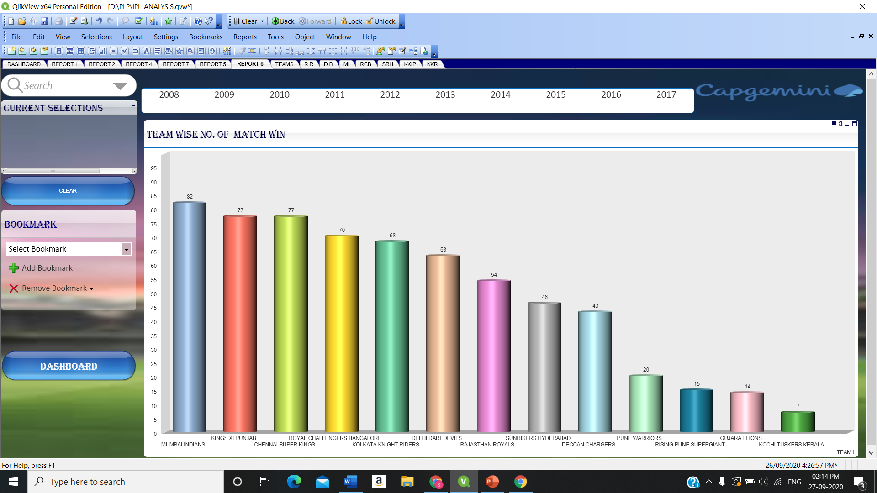
STAGE 3.3 : REPORTS
Fig 3.3.6 ANALYSIS VI

Slide 37

STAGE 4: TESTING
In the testing phase, all the implementations are integrated and deployed in the testing environment. Testers then follow Software Testing Life Cycle activities to check the system for errors, bugs, and defects to verify the system’s functionalities work as expected or not
Some of the test cases:
Handle null values
Handle duplicates
Table Structures consist of proper relationship
Loading of data
Visualization contains proper attributes and have some meanings.

Slide 38

THANK YOU!

